Slide 1
Online Shopper Purchasing Intent
- Final Report
Brock Ricker
05/05/2022

Slide 2
Summary
About the Data
Exploratory Analysis
Customer Segmentation
Modeling

Slide 3
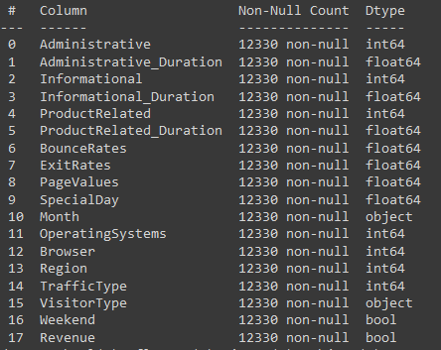
About the Data
Context
Consists of 12,330 online shopping “sessions”
Each session is unique, and data covers a 1 year period
Content
Target = “Revenue”
Did the session end in the customer purchasing something
10 numerical, and 7 categorical features
Visit information
PC info
Return/new customer
Location
Browsing History
Types of web pages, and time spent
Time of year accessed
Google analytics

Slide 4
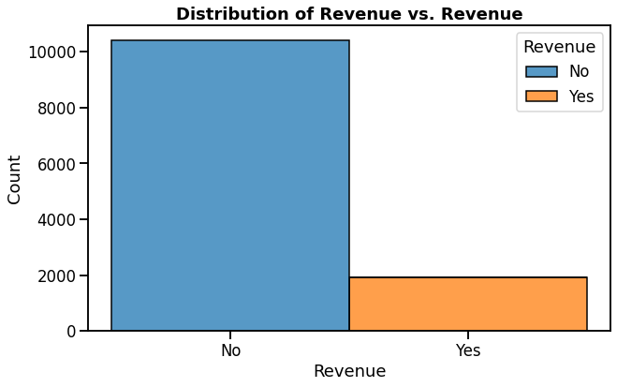
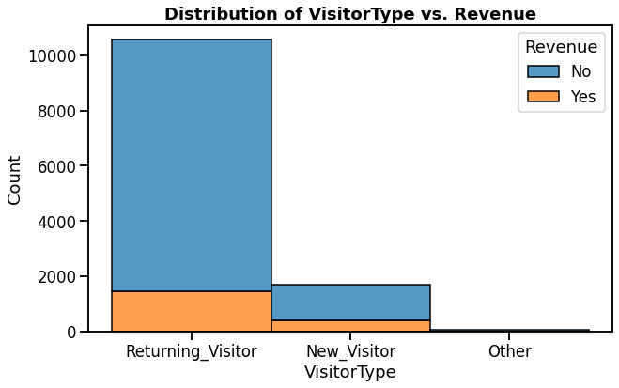
Exploratory Analysis
Majority of sessions (85%) do not result in a purchase
Majority of sessions (85%) are return customers

Slide 5
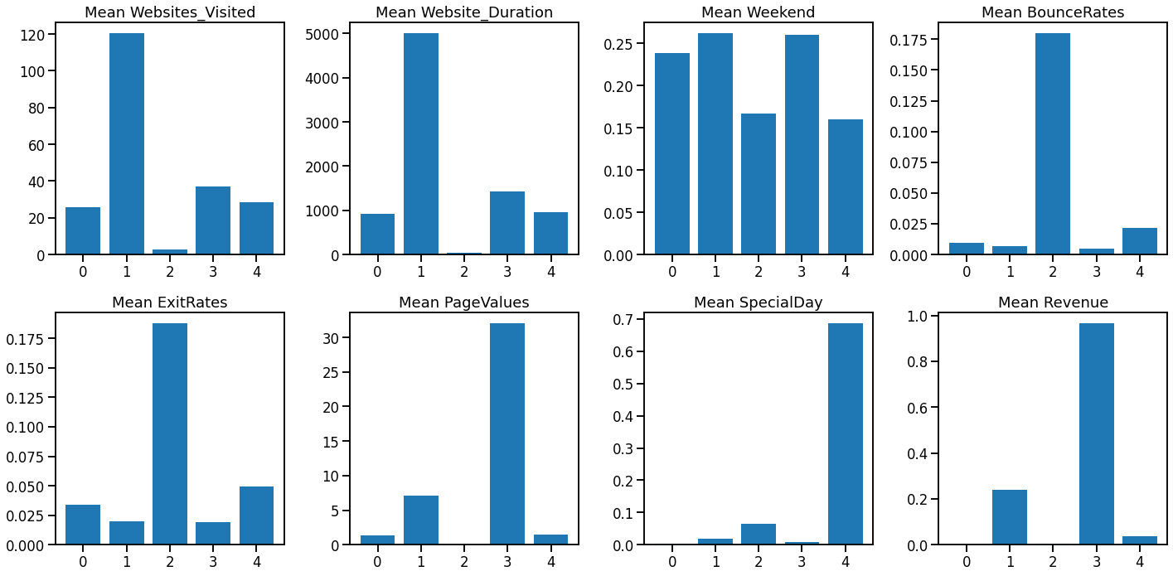
Customer Segmentation
Cluster 1 – Researchers
1160 Members (9%)
Visit the most sites
Spend the most amount of time on these sites
23% of sessions result in purchases

Slide 6
Customer Segmentation
Cluster 3 – The Buyers
1651 Members (13%)
Visit a moderate amount of sites
Spend a moderate amount of time
96% of sessions result in purchases

Slide 7
Customer Segmentation
Cluster 0 – The Almost Buyers
7681 Members (62%)
Most populous class
Similar browsing habits as buyers
Slightly less sites visited
Slightly less time spent
0% of sessions result in purchases

Slide 8
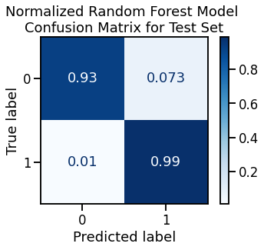
Modeling
Random Forest Model can predict online sessions that result in purchase with 99% accuracy
15% of sessions
Sessions with predicted sales can be ignored, as they are already resulting in revenue
Random Forest Model can predict online sessions that do not result in purchase with 97% accuracy
85% of sessions
Online marketing team should focus on these sessions to boost revenue
Most attention should be given to members of cluster 0 (almost buyers)
How to increase engagement time
Targeted adds
Recommended items

Slide 9
Thank You!
https://github.com/brock-ricker/Online-Shoppers-Purchasing-Intent

